Slide 1
Azure Reference Architectures
Session 06

Slide 2
AGENDA
Identity management
Hybrid network
Network DMZ
Managed web application
VM workloads
IoT
Data & BI

Slide 3
Reference architectures
Azure reference architectures are arranged by scenario, with related architectures grouped together.
Each architecture includes
Recommended practices
Considerations for scalability, availability, manageability, and security.
Intended to provide a footprint for your reference
Notes:
Microsoft Azure reference architectures are arranged by scenario, with related architectures grouped together. Each architecture includes recommended practices, along with considerations for scalability, availability, manageability, and security. Most also include a deployable solution.

Slide 4
Identity management
Notes:
In these reference architectures show options for integrating your on-premises Active Directory (AD) environment with an Azure network.

Slide 5
Integrate on-premises AD domains with Azure AD
Azure Active Directory (Azure AD) is a cloud-based multi-tenant directory and identity service.
This reference architecture shows best practices for integrating on-premises Active Directory domains with Azure AD to provide cloud-based identity authentication.
Notes:
Azure Active Directory (Azure AD) is a cloud-based multi-tenant directory and identity service. This reference architecture shows best practices for integrating on-premises Active Directory domains with Azure AD to provide cloud-based identity authentication.

Slide 6
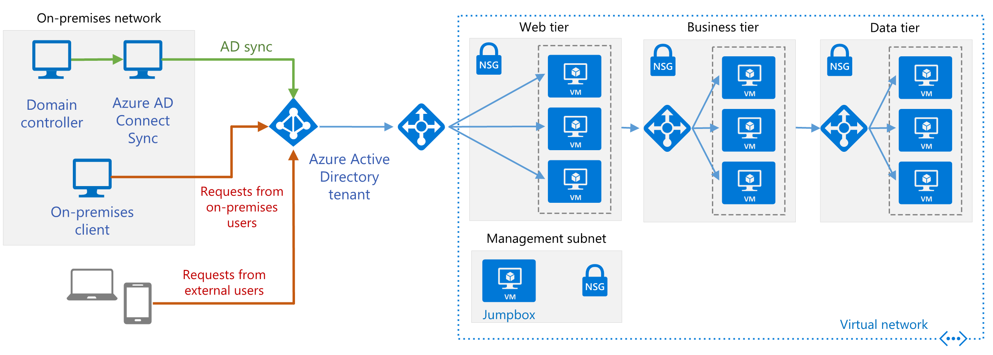
Integrate on-premises AD domains with Azure AD
Notes:
The architecture has the following components.
Azure AD tenant. An instance of Azure AD created by your organization. It acts as a directory service for cloud applications by storing objects copied from the on-premises Active Directory and provides identity services.
Web tier subnet. This subnet holds VMs that run a web application. Azure AD can act as an identity broker for this application.
On-premises AD DS server. An on-premises directory and identity service. The AD DS directory can be synchronized with Azure AD to enable it to authenticate on-premises users.
Azure AD Connect sync server. An on-premises computer that runs the Azure AD Connect sync service. This service synchronizes information held in the on-premises Active Directory to Azure AD. For example, if you provision or deprovision groups and users on-premises, these changes propagate to Azure AD.

Slide 7
Integrate on-premises AD domains with Azure AD
Typical uses for this reference architecture include:
Web applications deployed in Azure that provide access to remote users who belong to your organization.
Implementing self-service capabilities for end-users, such as resetting their passwords, and delegating group management
Architectures in which the on-premises network and the application's Azure VNet are not connected using a VPN tunnel or ExpressRoute circuit.
Notes:
Azure AD can authenticate the identity of users and applications that exist in an organization's directory. Some applications and services, such as SQL Server, may require computer authentication, in which case this solution is not appropriate.

Slide 8

Deploy AD DS in an Azure virtual network
Notes:
This architecture shows how to extend an on-premises Active Directory domain to Azure to provide distributed authentication services.
On-premises network. The on-premises network includes local Active Directory servers that can perform authentication and authorization for components located on-premises.
Active Directory servers. These are domain controllers implementing directory services (AD DS) running as VMs in the cloud. These servers can provide authentication of components running in your Azure virtual network.
Active Directory subnet. The AD DS servers are hosted in a separate subnet. Network security group (NSG) rules protect the AD DS servers and provide a firewall against traffic from unexpected sources.
Azure Gateway and Active Directory synchronization. The Azure gateway provides a connection between the on-premises network and the Azure VNet. This can be a VPN connection or Azure ExpressRoute. All synchronization requests between the Active Directory servers in the cloud and on-premises pass through the gateway. User-defined routes (UDRs) handle routing for on-premises traffic that passes to Azure.

Slide 9
Deploy AD DS in an Azure virtual network
Typical uses for this architecture include:
Hybrid applications in which functionality is distributed between on-premises and Azure
Applications and services that perform authentication using Active Directory.
Notes:
This architecture is commonly used when the on-premises network and the Azure virtual network are connected by a VPN or ExpressRoute connection. This architecture also supports bidirectional replication, meaning changes can be made either on-premises or in the cloud, and both sources will be kept consistent. Typical uses for this architecture include hybrid applications in which functionality is distributed between on-premises and Azure, and applications and services that perform authentication using Active Directory.

Slide 10
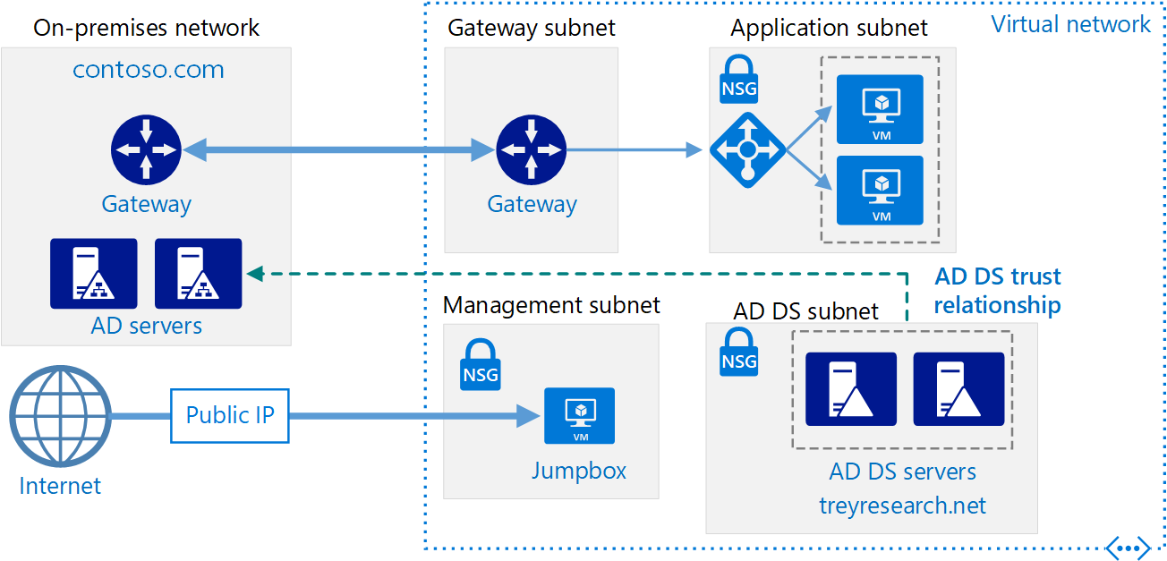
Create an AD DS resource forest in Azure
Notes:
This reference architecture shows how to create a separate Active Directory domain in Azure that is trusted by domains in your on-premises AD forest.
The architecture has the following components.
On-premises network. The on-premises network contains its own Active Directory forest and domains.
Active Directory servers. These are domain controllers implementing domain services running as VMs in the cloud. These servers host a forest containing one or more domains, separate from those located on-premises.
One-way trust relationship. The example in the diagram shows a one-way trust from the domain in Azure to the on-premises domain. This relationship enables on-premises users to access resources in the domain in Azure, but not the other way around.
Active Directory subnet. The AD DS servers are hosted in a separate subnet. Network security group (NSG) rules protect the AD DS servers and provide a firewall against traffic from unexpected sources.
Azure gateway. The Azure gateway provides a connection between the on-premises network and the Azure VNet. This can be a VPN connection or Azure ExpressRoute. For more information, see Connect an on-premises network to Azure using a VPN gateway.

Slide 11
Create an AD DS resource forest in Azure
Typical uses for this architecture include maintaining security separation for objects and identities held in the cloud, and migrating individual domains from on-premises to the cloud.
Notes:
Active Directory Domain Services (AD DS) stores identity information in a hierarchical structure. The top node in the hierarchical structure is known as a forest. A forest contains domains, and domains contain other types of objects. This reference architecture creates an AD DS forest in Azure with a one-way outgoing trust relationship with an on-premises domain. The forest in Azure contains a domain that does not exist on-premises. Because of the trust relationship, logons made against on-premises domains can be trusted for access to resources in the separate Azure domain.

Slide 12
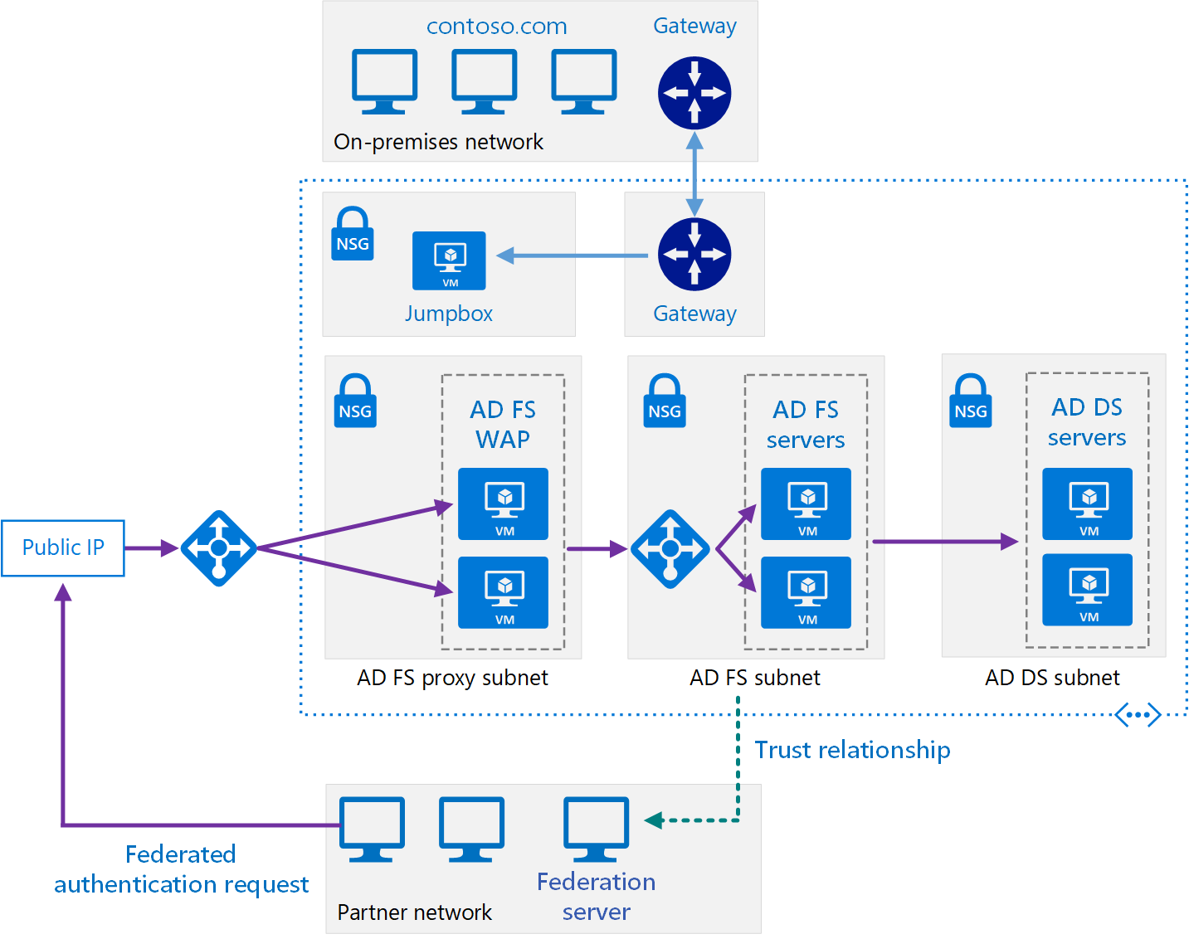
Extend on-premises AD FS to Azure
Notes:
This reference architecture implements a secure hybrid network that extends your on-premises network to Azure and uses Active Directory Federation Services (AD FS) to perform federated authentication and authorization for components running in Azure.
This architecture extends the implementation described in Extending AD DS to Azure. It contains the following components.
AD DS subnet. The AD DS servers are contained in their own subnet with network security group (NSG) rules acting as a firewall.
AD DS servers. Domain controllers running as VMs in Azure. These servers provide authentication of local identities within the domain.
AD FS subnet. The AD FS servers are located within their own subnet with NSG rules acting as a firewall.
AD FS servers. The AD FS servers provide federated authorization and authentication. In this architecture, they perform the following tasks:
Receiving security tokens containing claims made by a partner federation server on behalf of a partner user. AD FS verifies that the tokens are valid before passing the claims to the web application running in Azure to authorize requests.
The application running in Azure is the relying party. The partner federation server must issue claims that are understood by the web application. The partner federation servers are referred to as account partners, because they submit access requests on behalf of authenticated accounts in the partner organization. The AD FS servers are called resource partners because they provide access to resources (the web application).
Authenticating and authorizing incoming requests from external users running a web browser or device that needs access to web applications, by using AD DS and the Active Directory Device Registration Service.
The AD FS servers are configured as a farm accessed through an Azure load balancer. This implementation improves availability and scalability. The AD FS servers are not exposed directly to the Internet. All Internet traffic is filtered through AD FS web application proxy servers and a DMZ (also referred to as a perimeter network).
For more information about how AD FS works, see Active Directory Federation Services Overview. Also, the article AD FS deployment in Azure contains a detailed step-by-step introduction to implementation.
AD FS proxy subnet. The AD FS proxy servers can be contained within their own subnet, with NSG rules providing protection. The servers in this subnet are exposed to the Internet through a set of network virtual appliances that provide a firewall between your Azure virtual network and the Internet.
AD FS web application proxy (WAP) servers. These VMs act as AD FS servers for incoming requests from partner organizations and external devices. The WAP servers act as a filter, shielding the AD FS servers from direct access from the Internet. As with the AD FS servers, deploying the WAP servers in a farm with load balancing gives you greater availability and scalability than deploying a collection of stand-alone servers.

Slide 13
Extend on-premises AD FS to Azure
Typical uses for this architecture include:
Hybrid applications where workloads run partly on-premises and partly in Azure.
Solutions that use federated authorization to expose web applications to partner organizations.
Systems that support access from web browsers running outside of the organizational firewall.
Systems that enable users to access to web applications by connecting from authorized external devices such as remote computers, notebooks, and other mobile devices.
Notes:
The diagram shows the following scenarios:
Application code from a partner organization accesses a web application hosted inside your Azure VNet.
An external, registered user with credentials stored inside Active Directory Domain Services (DS) accesses a web application hosted inside your Azure VNet.
A user connected to your VNet using an authorized device executes a web application hosted inside your Azure VNet.

Slide 14
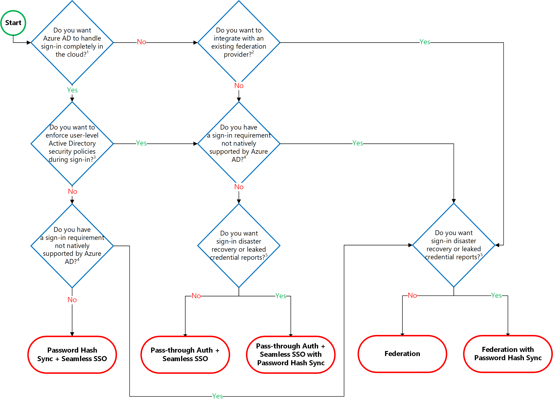
Hybrid identity auth decision workflow

Slide 15
Discussion
How to implement different components of a hybrid identity solution that integrates an Active Directory forest with an Azure Active Directory tenant and leverages additional Azure Active Directory features
SSO
MFA
Self-service password reset
Azure AD Password Protection for WinServer AD
Hybrid Azure AD join
Conditional Access
Azure AD proxy
Azure AD B2C, B2B

Slide 16
Discussion pt2 – Customer situation -Fabrikam
Fabrikam, a financial services company with HQ in São Paulo, and a branch office in Spain is looking to enable remote work.
Lack of controls to prevent unathorized Access to systems
Using traditional VPNs / Direct Access
Running on-premises infrastructure on Windows platform
Consider implementing policies to allow employees work from home
1 AD domain forest was implemented a few years ago
AD domain uses a non-routable DNS name fabrikam.local
Directory Services did not implement domain name
Fabrikam owns a publicly routable DNS domain name fabrikam.com
AD domain recently upgraded to Windows Server 2016
Most of the servers are running WinServer 2016

Slide 17
Discussion pt. 3 – Customer objectives
Support for remote workforce and integration with customers and partners
Remote uses must be able to sign in using their AD creds to their devices
Users must be able to reset their own passwords, prevent use of common terms in passwords
Implement new identity capabilities including authentication, per-app permissions.
Expand partnerships with other organizations:
Fabrikam established business relationships with OneFinance
OneFinance manages an extensive portfolio of mortgage related products
Fabrikam intends to provide OneFinance with access to its internal WIA-based web applications to facilitate integration with the existing OneFinance products
OneFinance has already moved its operations almost entirely to Azure
Provide Access to services to external clients.
Critical application are running on-premises and rely on Kerberos-based auth
Fabrikam remote users should be able to access on-premises applications
Contoso users should be able to access on-premises applications

Slide 18
Hybrid Network

Slide 19
Extend an on-premises network using VPN
This reference architecture shows how to extend a network from on premises or from Azure Stack into an Azure virtual network, using a site-to-site virtual private network (VPN).
Traffic flows between the on-premises network and Azure through an IPSec VPN tunnel or through the Azure Stack multitenant VPN gateway.

Slide 20
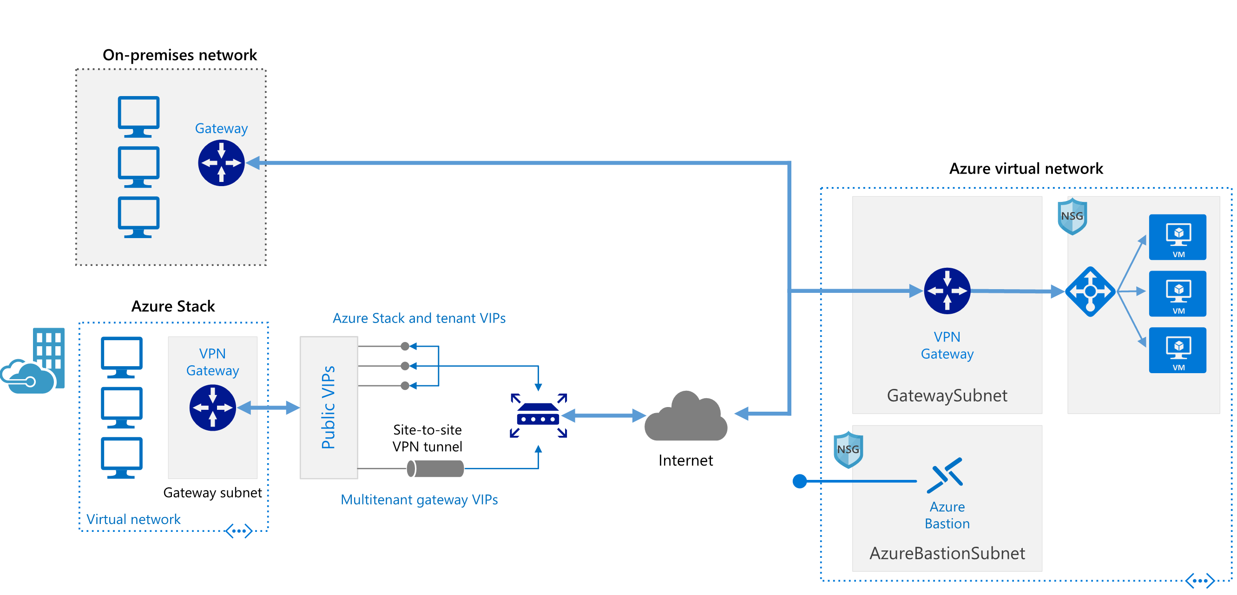

Extend an on-premises network using VPN
https://github.com/mspnp/reference-architectures/blob/master/hybrid-networking/vpn/README.md
Notes:
The architecture consists of the following components.
On-premises network. A private local-area network running within an organization.
Azure Stack. A network environment on an Azure Stack tenant subscription, running within an organization. The Azure Stack VPN gateway sends encrypted traffic across a public connection to virtual IP (VIP) addresses and includes the following components:
Gateway subnet. A special subnet required to deploy the VPN Gateway on Azure Stack.
Local network gateway. Indicates the target IP of the VPN gateway in Azure, as well as the address space of the Azure virtual network.
Site-to-site VPN tunnel. The connection type (IPSec) and the key shared with the Azure VPN Gateway to encrypt traffic.
VPN appliance. A device or service that provides external connectivity to the on-premises network. The VPN appliance may be a hardware device, or it can be a software solution such as the Routing and Remote Access Service (RRAS) in Windows Server 2012. For a list of supported VPN appliances and information on configuring them to connect to an Azure VPN gateway, see the instructions for the selected device in the article About VPN devices for Site-to-Site VPN Gateway connections.
Virtual network. The cloud application and the components for the Azure VPN gateway reside in the same virtual network.
Azure VPN gateway. The VPN gateway service enables you to connect the virtual network to the on-premises network through a VPN appliance or to connect to Azure Stack through a site-to-site VPN tunnel. For more information, see Connect an on-premises network to a Microsoft Azure virtual network. The VPN gateway includes the following elements:
Virtual network gateway. A resource that provides a virtual VPN appliance for the virtual network. It is responsible for routing traffic from the on-premises network to the virtual network.
Local network gateway. An abstraction of the on-premises VPN appliance. Network traffic from the cloud application to the on-premises network is routed through this gateway.
Connection. The connection has properties that specify the connection type (IPSec) and the key shared with the on-premises VPN appliance to encrypt traffic.
Gateway subnet. The virtual network gateway is held in its own subnet, which is subject to various requirements, described in the Recommendations section below.
Cloud application. The application hosted in Azure. It might include multiple tiers, with multiple subnets connected through Azure load balancers. For more information about the application infrastructure, see Running Windows VM workloads and Running Linux VM workloads.
Internal load balancer. Network traffic from the VPN gateway is routed to the cloud application through an internal load balancer. The load balancer is located in the front-end subnet of the application.
Bastion. Azure Bastion allows you to log into VMs in the virtual network through SSH or remote desktop protocol (RDP) without exposing the VMs directly to the internet. If you lose connectivity through the VPN, you can still use Bastion to manage the VMs in the virtual network.

Slide 21
Extend an on-premises network using ExpressRoute
This reference architecture shows how to connect an on-premises network to virtual networks on Azure, using Azure ExpressRoute.
ExpressRoute connections use a private, dedicated connection through a third-party connectivity provider.
The private connection extends your on-premises network into Azure.

Slide 22
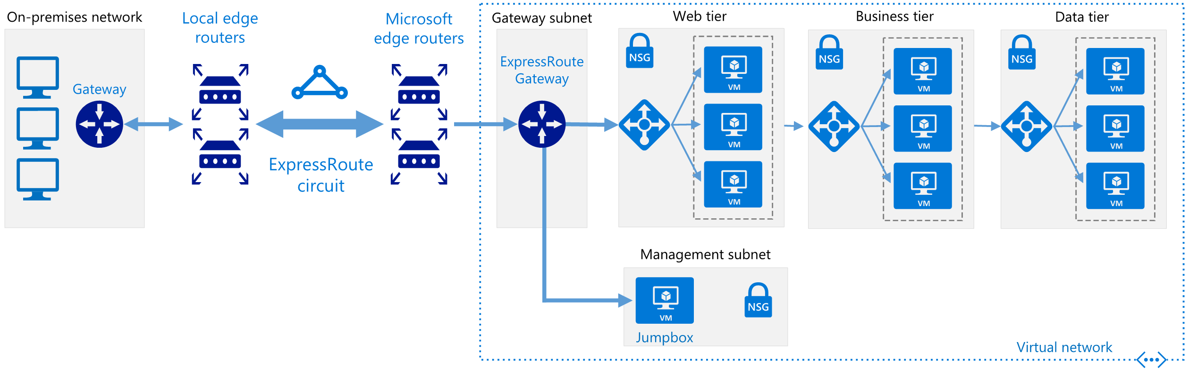
Extend an on-premises network using ExpressRoute
https://docs.microsoft.com/en-us/azure/architecture/reference-architectures/hybrid-networking/expressroute#deploy-the-solution
Notes:
The architecture consists of the following components.
On-premises corporate network. A private local-area network running within an organization.
ExpressRoute circuit. A layer 2 or layer 3 circuit supplied by the connectivity provider that joins the on-premises network with Azure through the edge routers. The circuit uses the hardware infrastructure managed by the connectivity provider.
Local edge routers. Routers that connect the on-premises network to the circuit managed by the provider. Depending on how your connection is provisioned, you may need to provide the public IP addresses used by the routers.
Microsoft edge routers. Two routers in an active-active highly available configuration. These routers enable a connectivity provider to connect their circuits directly to their datacenter. Depending on how your connection is provisioned, you may need to provide the public IP addresses used by the routers.
Azure virtual networks (VNets). Each VNet resides in a single Azure region, and can host multiple application tiers. Application tiers can be segmented using subnets in each VNet.
Azure public services. Azure services that can be used within a hybrid application. These services are also available over the Internet, but accessing them using an ExpressRoute circuit provides low latency and more predictable performance, because traffic does not go through the Internet.
Microsoft 365 services. The publicly available Microsoft 365 applications and services provided by Microsoft. Connections are performed using Microsoft peering, with addresses that are either owned by your organization or supplied by your connectivity provider. You can also connect directly to Microsoft CRM Online through Microsoft peering.
Connectivity providers (not shown). Companies that provide a connection either using layer 2 or layer 3 connectivity between your datacenter and an Azure datacenter.

Slide 23
ExpressRoute with VPN failover
This reference architecture shows how to connect an on-premises network to an Azure virtual network (VNet) using ExpressRoute, with a site-to-site virtual private network (VPN) as a failover connection.
Traffic flows between the on-premises network and the Azure VNet through an ExpressRoute connection.
If there is a loss of connectivity in the ExpressRoute circuit, traffic is routed through an IPSec VPN tunnel.
Notes:
Note that if the ExpressRoute circuit is unavailable, the VPN route will only handle private peering connections. Public peering and Microsoft peering connections will pass over the Internet.

Slide 24
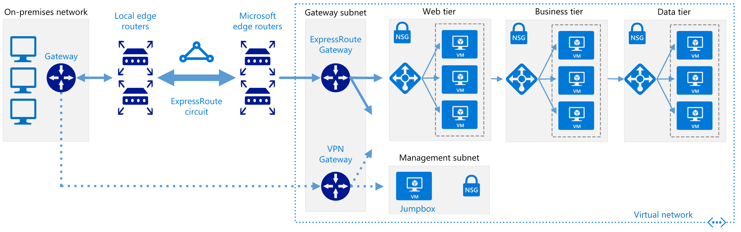
ExpressRoute with VPN failover
Notes:
The architecture consists of the following components.
On-premises network. A private local-area network running within an organization.
VPN appliance. A device or service that provides external connectivity to the on-premises network. The VPN appliance may be a hardware device, or it can be a software solution such as the Routing and Remote Access Service (RRAS) in Windows Server 2012. For a list of supported VPN appliances and information on configuring selected VPN appliances for connecting to Azure, see About VPN devices for Site-to-Site VPN Gateway connections.
ExpressRoute circuit. A layer 2 or layer 3 circuit supplied by the connectivity provider that joins the on-premises network with Azure through the edge routers. The circuit uses the hardware infrastructure managed by the connectivity provider.
ExpressRoute virtual network gateway. The ExpressRoute virtual network gateway enables the VNet to connect to the ExpressRoute circuit used for connectivity with your on-premises network.
VPN virtual network gateway. The VPN virtual network gateway enables the VNet to connect to the VPN appliance in the on-premises network. The VPN virtual network gateway is configured to accept requests from the on-premises network only through the VPN appliance. For more information, see Connect an on-premises network to a Microsoft Azure virtual network.
VPN connection. The connection has properties that specify the connection type (IPSec) and the key shared with the on-premises VPN appliance to encrypt traffic.
Azure Virtual Network (VNet). Each VNet resides in a single Azure region, and can host multiple application tiers. Application tiers can be segmented using subnets in each VNet.
Gateway subnet. The virtual network gateways are held in the same subnet.
Cloud application. The application hosted in Azure. It might include multiple tiers, with multiple subnets connected through Azure load balancers. For more information about the application infrastructure, see Running Windows VM workloads and Running Linux VM workloads.

Slide 25
Hub-spoke network topology in Azure
This reference architecture details a hub-spoke topology in Azure. The hub virtual network acts as a central point of connectivity to many spoke virtual networks.
The hub can also be used as the connectivity point to your on-premises networks.
The spoke virtual networks peer with the hub and can be used to isolate workloads.
Notes:
The benefits of using a hub and spoke configuration include cost savings, overcoming subscription limits, and workload isolation.

Slide 26
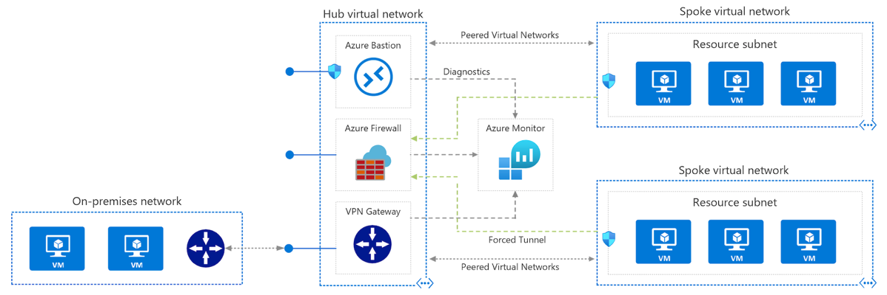
Hub-spoke network topology in Azure
https://docs.microsoft.com/en-us/samples/mspnp/samples/hub-and-spoke-deployment/
Notes:
The benefits of using a hub and spoke configuration include cost savings, overcoming subscription limits, and workload isolation.
Hub virtual network: The hub virtual network is the central point of connectivity to your on-premises network and a place to host services that can be consumed by the different workloads hosted in the spoke virtual networks.
Spoke virtual networks: Spoke virtual networks are used to isolate workloads in their own virtual networks, managed separately from other spokes. Each workload might include multiple tiers, with multiple subnets connected through Azure load balancers.
Virtual network peering: Two virtual networks can be connected using a peering connection. Peering connections are non-transitive, low latency connections between virtual networks. Once peered, the virtual networks exchange traffic by using the Azure backbone without the need for a router.
Bastion Host: Azure Bastion lets you securely connect to a virtual machine using your browser and the Azure portal. An Azure Bastion host is deployed inside an Azure Virtual Network and can access virtual machines in the VNet, or virtual machines in peered VNets.
Azure Firewall: Azure Firewall is a managed firewall as a service. The Firewall instance is placed in its own subnet.
VPN virtual network gateway or ExpressRoute gateway. The virtual network gateway enables the virtual network to connect to the VPN device, or ExpressRoute circuit, used for connectivity with your on-premises network. For more information, see Connect an on-premises network to a Microsoft Azure virtual network.
VPN device. A device or service that provides external connectivity to the on-premises network. The VPN device may be a hardware device or a software solution such as the Routing and Remote Access Service (RRAS) in Windows Server 2012. For more information, see About VPN devices for Site-to-Site VPN Gateway connections.

Slide 27
Hub-spoke network topology in Azure
Typical uses for this architecture include:
Workloads deployed in different environments, such as development, testing, and production, that require shared services such as DNS, IDS, NTP, or AD DS. Shared services are placed in the hub virtual network, while each environment is deployed to a spoke to maintain isolation.
Workloads that do not require connectivity to each other but require access to shared services.
Enterprises that require central control over security aspects, such as a firewall in the hub as a DMZ, and segregated management for the workloads in each spoke.
Notes:
The benefits of using a hub and spoke configuration include cost savings, overcoming subscription limits, and workload isolation.

Slide 28
DMZ between Azure and your on-premises datacenter
This reference architecture shows a secure hybrid network that extends an on-premises network to Azure.
The architecture implements a DMZ, also called a perimeter network, between the on-premises network and an Azure virtual network.
All inbound and outbound traffic passes through Azure Firewall.

Slide 29
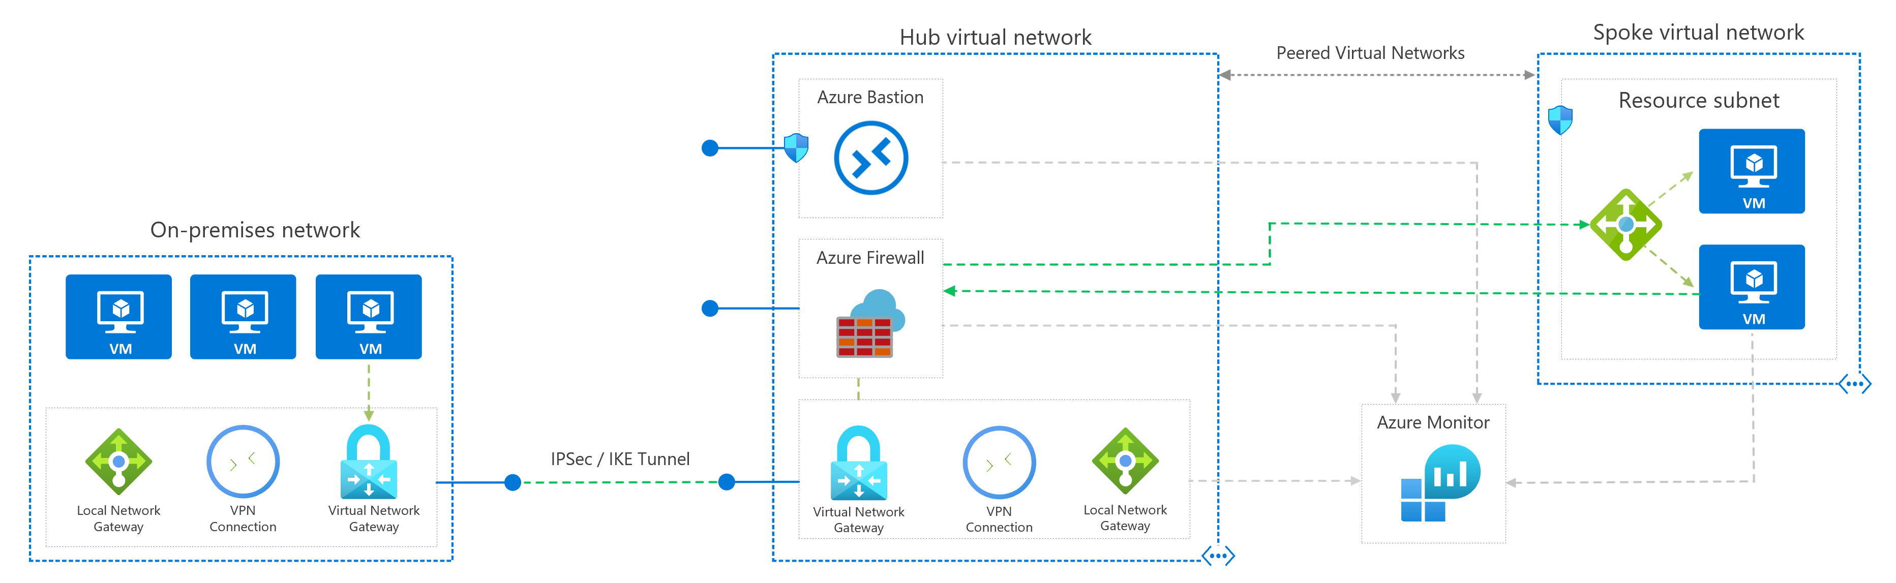
DMZ between Azure and your on-premises datacenter
Notes:
The architecture consists of the following components.
On-premises network. A private local-area network implemented in an organization.
Azure virtual network. The virtual network hosts the application and other resources running in Azure.
Gateway. The gateway provides connectivity between the routers in the on-premises network and the virtual network. The gateway is placed in its own subnet.
Azure Firewall. Azure Firewall is a managed firewall as a service. The Firewall instance is placed in its own subnet.
Virtual network routes. Virtual network routes define the flow of IP traffic within the Azure virtual network. In the diagram shown above, there are two user-defined route tables.
In the gateway subnet, traffic sent to the web-tier subnet (10.0.1.0/24) is routed through the Azure Firewall instance.
In the web tier subnet, Since there is no route for address space of the VNet itself to point to Azure firewall, web tier instances are able to communicate directly to each other, not via Azure Firewall.
Network security groups. Use security groups to restrict network traffic within the virtual network. For example, in the deployment provided with this reference architecture, the web tier subnet allows TCP traffic from the on-premises network and from within the virtual network; the business tier allows traffic from the web tier, and the data tier allows traffic from the business tier.
Bastion. Azure Bastion allows you to log into VMs in the virtual network through SSH or remote desktop protocol (RDP) without exposing the VMs directly to the internet. Use Bastion to manage the VMs in the virtual network.

Slide 30
DMZ between Azure and your on-premises datacenter
Use Cases
Hybrid applications where workloads run partly on-premises and partly in Azure.
Infrastructure that requires granular control over traffic entering an Azure virtual network from an on-premises datacenter.
Applications that must audit outgoing traffic. This is often a regulatory requirement of many commercial systems and can help to prevent public disclosure of private information.

Slide 31
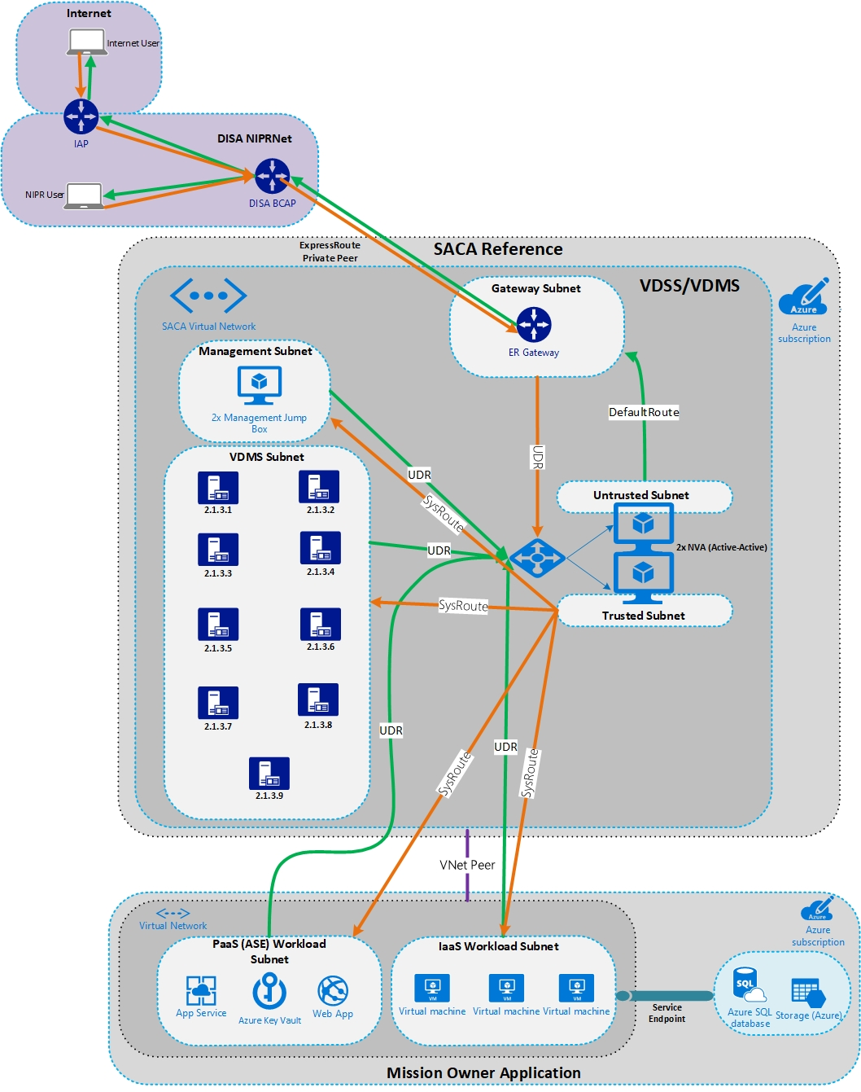
Secure Azure Computing Architecture
Notes:
U.S. Department of Defense (DoD) customers who deploy workloads to Azure have asked for guidance to set up secure virtual networks and configure the security tools and services that are stipulated by DoD standards and practice.
Secure Cloud Computing Architecture (SCCA) has four components:
Boundary Cloud Access Point (BCAP)
Virtual Datacenter Security Stack (VDSS)
Virtual Datacenter Managed Services (VDMS)
Trusted Cloud Credential Manager (TCCM)
Azure native tools in the following list to meet various requirements of SCCA:
Azure Monitor
Azure Security Center
Azure Network Watcher
Azure Key Vault
Azure Active Directory
Azure Application Gateway
Azure Firewall
Azure Front Door
Azure security groups
Azure DDoS Protection
Azure Sentinel

Slide 32
Discussion
How to configure an enterprise-class network within Azure.
Consider the technologies to connect multiple virtual networks, as well as using capabilities such as routing to deploy network virtual appliances in Azure and services to secure your deployment.

Slide 33
Discussion pt2 – Customer situation -Fabrikam
Fabrikam stands at the forefront of technological advancement in the ports industry.
Headquartered in Miami, FL. 2 separate offices.
3 US branches in several states over the south US
Fabrikam want to run their core application on the cloud.
Application, Terminal Management System, developed in 2001 by in-house terminal expertise and logistics experts enabling Fabrikam to increase capacity, service and profitability. nGen optimises, innovates and collaborates terminals with operations intelligences, execution and control, reporting and inventory.
Fabrikam is looking for a hybrid solution. Currently using NLB in 2 sites to enable access to the applications per site. No redundancy across site is enabled.

Slide 34
Discussion pt3 – Fabrikam needs
NetOps team is considering options to redirect traffic using an on-premises gateway for this deployment.
Fabrikam wants to run a pilot in the cloud
The core application will be fully running on cloud
Fabrikam needs to address the virtual networking architecture and support secure data flow between their on-premises infrastructure and the cloud.
Fabrikam wants to keep their 10gig connectivity between the HQs with 2 sites and the cloud. US branches should also be able to have private connections to the cloud.
NetOps team requires the ability to analyze traffic flows and detect potential vulnerabilities near real time.

Slide 35
Managed web application

Slide 36
Basic web application
This architecture shows a baseline deployment for a web application that uses Azure App Service and Azure SQL Database.
Notes:
Recommendations
• Use the Standard or Premium tiers, because they support scale out, autoscale, and secure sockets layer (SSL).
• Provision the App Service plan and the SQL Database in the same region to minimize network latency.
• Enable autoscaling. If your application has a predictable, regular workload, schedule the instance counts ahead of time. If the workload is not predictable, use rule-based
autoscaling to react to changes in load.
• Create a staging slot to deploy updates. By using a staging slot, you can verify the deployment succeeded, before swapping it into production. Using a staging slot also
ensures that all instances are warmed up before being swapped into production.
• Don't use slots on your production deployment for testing, because all apps within the same App Service plan share the same VM instances. Instead, put test
deployments into a separate App Service plan to isolate them from the production version.
• Store configuration settings as app settings. Define the app settings in your Resource Manager templates, or using PowerShell. Never check passwords, access keys, or
connection strings into source control. Instead, pass these as parameters to a deployment script that stores these values as app settings.
• Consider using App Service authentication to implement authentication with an identity provider such as Azure Active Directory, Facebook, Google, or Twitter.
• Use SQL Database point-in-time restore to recover from human error by returning the database to an earlier point in time. Use geo-restore to recover from a service
outage by restoring a database from a geo-redundant backup

Slide 37
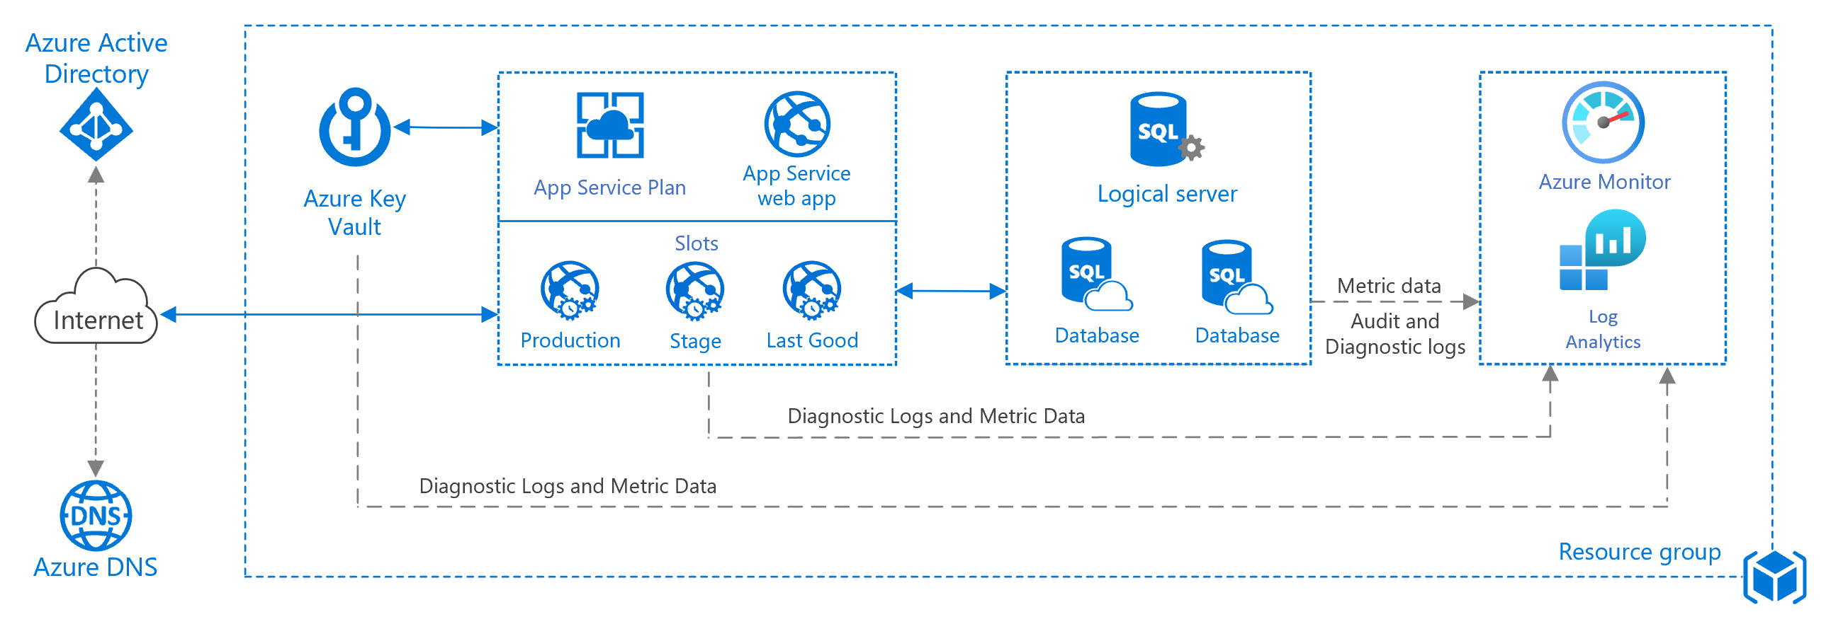
Basic web application
Notes:
The architecture consists of the following components.
App Service plan: An App Service plan provides the managed virtual machines (VMs) that host your app. All apps associated with a plan run on the same VM instances.
App Service app: Azure App Service is a fully managed platform for creating and deploying cloud applications.
Deployment slots: A deployment slot lets you stage a deployment and then swap it with the production deployment. That way, you avoid deploying directly into production. See the Manageability section for specific recommendations.
IP address: The App Service app has a public IP address and a domain name. The domain name is a subdomain of azurewebsites.net, such as contoso.azurewebsites.net.
Azure DNS: Azure DNS is a hosting service for DNS domains, providing name resolution using Microsoft Azure infrastructure. By hosting your domains in Azure, you can manage your DNS records using the same credentials, APIs, tools, and billing as your other Azure services. To use a custom domain name (such as contoso.com) create DNS records that map the custom domain name to the IP address. For more information, see Configure a custom domain name in Azure App Service.
Azure SQL Database: SQL Database is a relational database-as-a-service in the cloud. SQL Database shares its code base with the Microsoft SQL Server database engine. Depending on your application requirements, you can also use Azure Database for MySQL or Azure Database for PostgreSQL. These are fully managed database services based on the open-source MySQL Server and Postgres database engines.

Slide 38
Scalable web application
This reference architecture shows proven practices for improving scalability and performance in an Azure App Service web application.

Slide 39
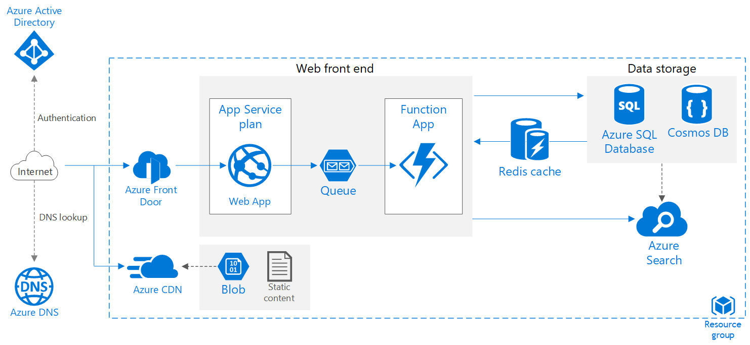
Scalable web application
Notes:
Web app. A typical modern application might include both a website and one or more RESTful web APIs. A web API might be consumed by browser clients through AJAX, by native client applications, or by server-side applications. For considerations on designing web APIs, see API design guidance.
Front Door. Front Door is a layer 7 load balancer. In this architecture, it routes HTTP requests to the web front end. Front Door also provides a web application firewall (WAF) that protects the application from common exploits and vulnerabilities.
Function App. Use Function Apps to run background tasks. Functions are invoked by a trigger, such as a timer event or a message being placed on queue. For long-running stateful tasks, use Durable Functions.
Queue. In the architecture shown here, the application queues background tasks by putting a message onto an Azure Queue storage queue. The message triggers a function app. Alternatively, you can use Service Bus queues. For a comparison, see Azure Queues and Service Bus queues - compared and contrasted.
Cache. Store semi-static data in Azure Cache for Redis.
CDN. Use Azure Content Delivery Network (CDN) to cache publicly available content for lower latency and faster delivery of content.
Data storage. Use Azure SQL Database for relational data. For non-relational data, consider Cosmos DB.
Azure Cognitive Search. Use Azure Cognitive Search to add search functionality such as search suggestions, fuzzy search, and language-specific search. Azure Search is typically used in conjunction with another data store, especially if the primary data store requires strict consistency. In this approach, store authoritative data in the other data store and the search index in Azure Search. Azure Search can also be used to consolidate a single search index from multiple data stores.
Azure DNS. Azure DNS is a hosting service for DNS domains, providing name resolution using Microsoft Azure infrastructure. By hosting your domains in Azure, you can manage your DNS records using the same credentials, APIs, tools, and billing as your other Azure services.

Slide 40
Serverless web application
This reference architecture shows a serverless web application. The application serves static content from Azure Blob Storage, and implements an API using Azure Functions.
The API reads data from Cosmos DB and returns the results to the web app.
Notes:
The term serverless has two distinct but related meanings:
Backend as a service (BaaS). Back-end cloud services, such as databases and storage, provide APIs that enable client applications to connect directly to these services.
Functions as a service (FaaS). In this model, a "function" is a piece of code that is deployed to the cloud and runs inside a hosting environment that completely abstracts the servers that run the code.

Slide 41
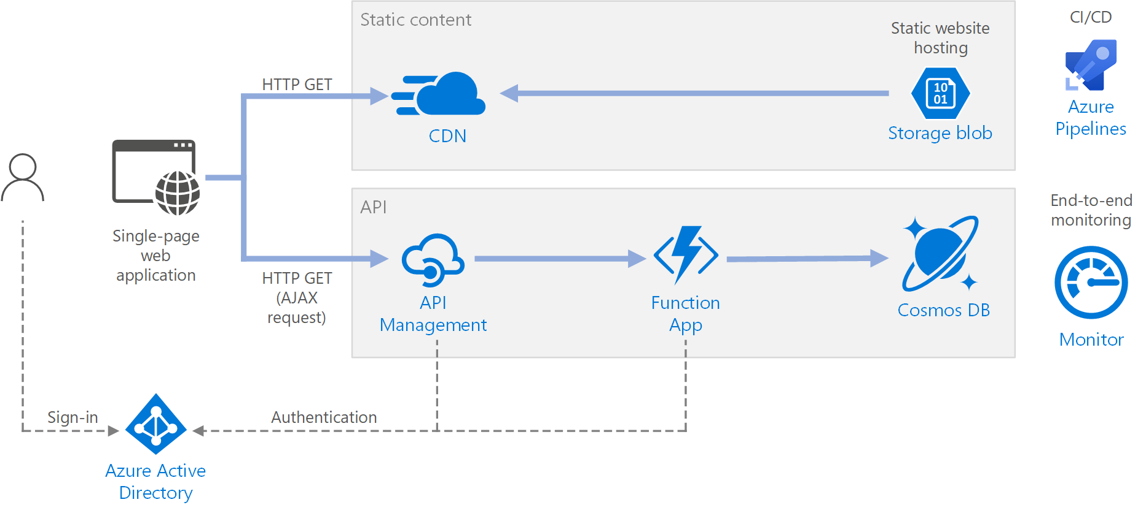
Serverless web application
Notes:
The architecture consists of the following components:
Blob Storage. Static web content, such as HTML, CSS, and JavaScript files, are stored in Azure Blob Storage and served to clients by using static website hosting. All dynamic interaction happens through JavaScript code making calls to the back-end APIs. There is no server-side code to render the web page. Static website hosting supports index documents and custom 404 error pages.
CDN. Use Azure Content Delivery Network (CDN) to cache content for lower latency and faster delivery of content, as well as providing an HTTPS endpoint.
Function Apps. Azure Functions is a serverless compute option. It uses an event-driven model, where a piece of code (a "function") is invoked by a trigger. In this architecture, the function is invoked when a client makes an HTTP request. The request is always routed through an API gateway, described below.
API Management. API Management provides an API gateway that sits in front of the HTTP function. You can use API Management to publish and manage APIs used by client applications. Using a gateway helps to decouple the front-end application from the back-end APIs. For example, API Management can rewrite URLs, transform requests before they reach the back end, set request or response headers, and so forth.
API Management can also be used to implement cross-cutting concerns such as:
Enforcing usage quotas and rate limits
Validating OAuth tokens for authentication
Enabling cross-origin requests (CORS)
Caching responses
Monitoring and logging requests
If you don't need all of the functionality provided by API Management, another option is to use Functions Proxies. This feature of Azure Functions lets you define a single API surface for multiple function apps, by creating routes to back-end functions. Function proxies can also perform limited transformations on the HTTP request and response. However, they don't provide the same rich policy-based capabilities of API Management.
Cosmos DB. Cosmos DB is a multi-model database service. For this scenario, the function application fetches documents from Cosmos DB in response to HTTP GET requests from the client.
Azure Active Directory (Azure AD). Users sign into the web application by using their Azure AD credentials. Azure AD returns an access token for the API, which the web application uses to authenticate API requests (see Authentication).
Azure Monitor. Monitor collects performance metrics about the Azure services deployed in the solution. By visualizing these in a dashboard, you can get visibility into the health of the solution. It also collected application logs.
Azure Pipelines. Pipelines is a continuous integration (CI) and continuous delivery (CD) service that builds, tests, and deploys the application.

Slide 42
Web application in multiple Azure regions for high availability
This reference architecture shows how to run an Azure App Service application in multiple regions to achieve high availability.
Notes:
A multi-region architecture can provide higher availability than deploying to a single region. If a regional outage affects the primary region, you can use Front Door to fail over to the secondary region. This architecture can also help if an individual subsystem of the application fails.

Slide 43

Web application in multiple Azure regions for high availability
Notes:
This architecture builds on the one shown in Improve scalability in a web application. The main differences are:
Primary and secondary regions. This architecture uses two regions to achieve higher availability. The application is deployed to each region. During normal operations, network traffic is routed to the primary region. If the primary region becomes unavailable, traffic is routed to the secondary region.
Front Door. Front Door routes incoming requests to the primary region. If the application running that region becomes unavailable, Front Door fails over to the secondary region.
Geo-replication of SQL Database and/or Cosmos DB.

Slide 44
VM workloads

Slide 45
Run a Windows | Linux VM on Azure
This architecture shows a Linux virtual machine (VM) running on Azure, along with associated networking and storage components.
This architecture can be used to run a single instance, and is the basis for more complex architectures such as n-tier applications
Notes:
Provisioning a virtual machine (VM) in Azure requires some additional components besides the VM itself, including networking and storage resources. This article shows best practices for running a Windows VM on Azure.

Slide 46
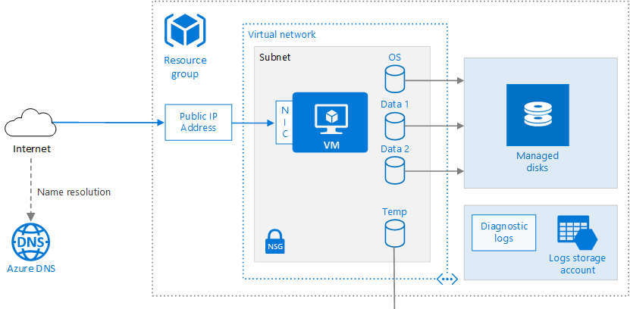
Run a Windows | Linux VM on Azure
Notes:
Provisioning a virtual machine (VM) in Azure requires some additional components besides the VM itself, including networking and storage resources. This article shows best practices for running a Windows VM on Azure.
Architecture Components
Recommendations
• For best disk I/O performance, we recommend Premium Storage, which stores data on solid-state drives (SSDs).
• Use Managed disks, which do not require a storage account. You simply specify the size and type of disk and it is deployed in a highly available way.
• Attach a data disk for persistent storage of application data.
• Enable monitoring and diagnostics, including health metrics, diagnostics infrastructure logs, and boot diagnostics.
• Add an NSG to the subnet to allow/deny network traffic to the subnet. To enable SSH, add a rule to the NSG that allows inbound traffic to TCP port 22.
• Reserve a static IP address if you need a fixed IP address that won't change — for example, if you need to create an A record in DNS, or need the IP address to be added
to a safe list.
• For higher availability, deploy multiple VMs behind a load balancer. See [Load balanced VMs reference architecture]
• Use Azure Security Center to get a central view of the security state of your Azure resources. Security Center monitors potential security issues and provides a
comprehensive picture of the security health of your deployment.
• Consider Azure Disk Encryption if you need to encrypt the OS and data disks.
Resource Group
A resource group is a container that holds related resources.
You usually create resource groups for different resources in
a solution based on their lifetime, and who will manage the
resources. For a single VM workload, you may create a single
resource group for all resources.
VM
Azure supports running various popular Linux distributions,
including CentOS, Debian, Red Hat Enterprise, Ubuntu, and
FreeBSD. For more information, see Azure and Linux. You can
provision a VM from a list of published images or from a
virtual hard disk (VHD) file that you upload to Azure Blob
storage.
OS disk
The OS disk is a VHD stored in Azure Storage. That means it
persists even if the host machine goes down. The OS disk is
/dev/sda1.
Data disks
A data disk is a persistent VHD used for application data.
Data disks are stored in Azure Storage, like the OS disk.
Virtual network (VNet) and subnet
Every VM in Azure is deployed into a VNet that is further
divided into subnets.
Public IP address
A public IP address is needed to communicate with the VM
— for example over SSH.
Network interface (NIC)
The NIC enables the VM to communicate with the virtual
network.
Network security group (NSG)
The NSG is used to allow/deny network traffic to the subnet.
You can associate an NSG with an individual NIC or with a
subnet. If you associate it with a subnet, the NSG rules apply
to all VMs in that subnet.
Diagnostics
Diagnostic logging is crucial for managing and
troubleshooting the VM

Slide 47
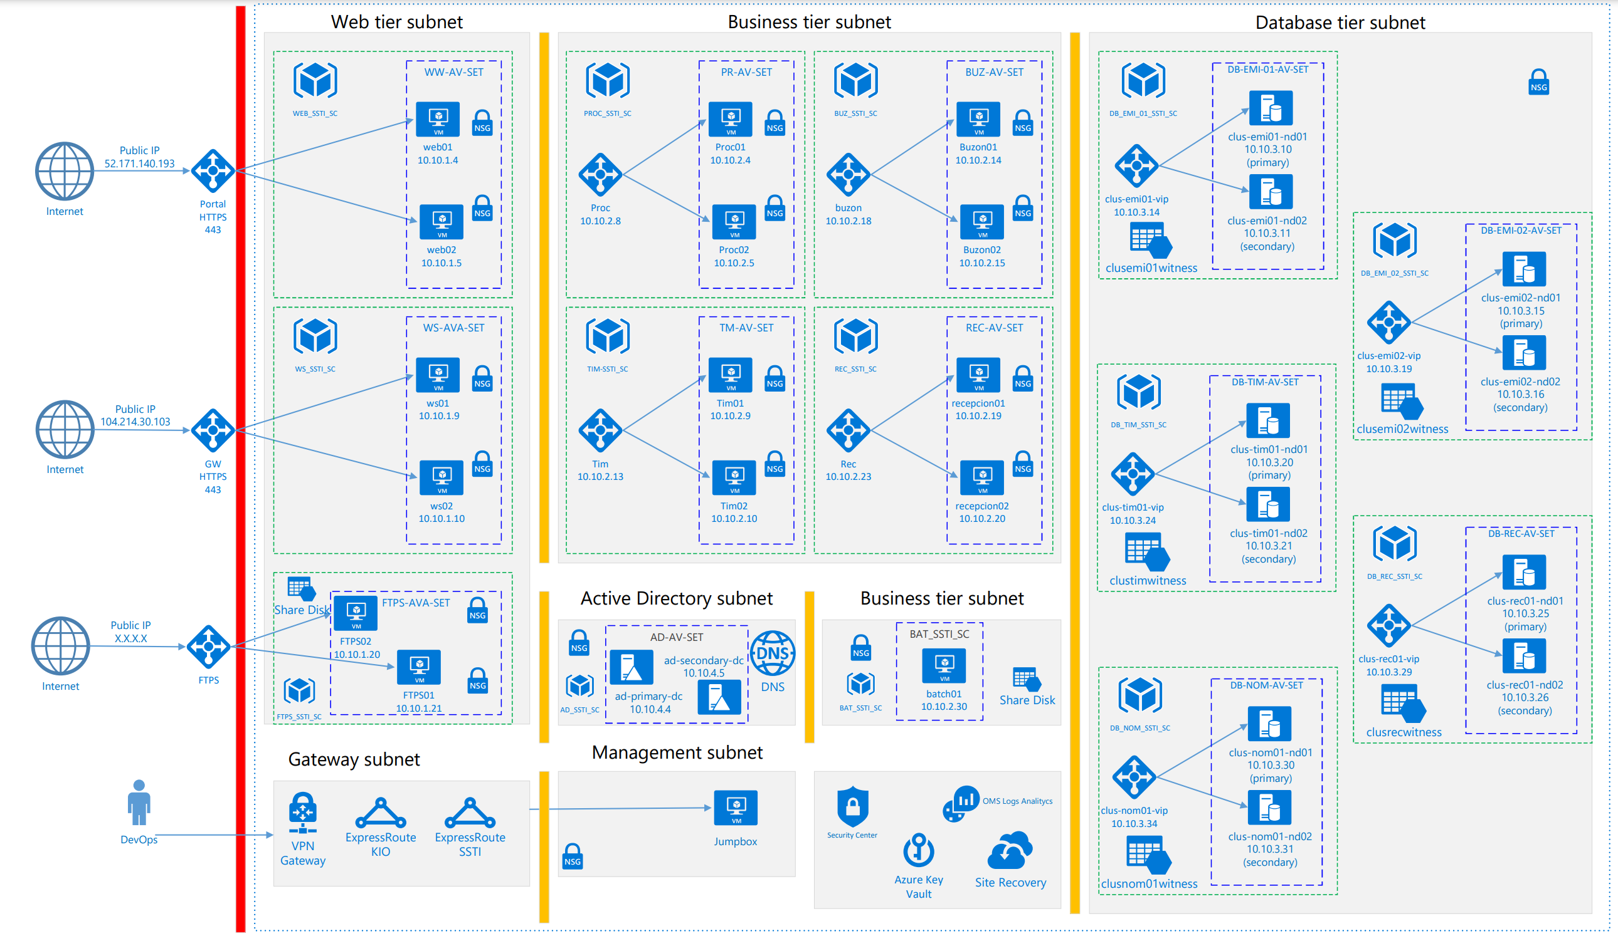
Discusssion - Tax management system

Slide 48
Internet Of Things

Slide 49
Azure IoT reference architecture
The architecture we recommend for IoT solutions is cloud native, microservice, and serverless-based.
The IoT solution subsystems should be built as discrete services that are independently deployable, and able to scale independently.
These attributes enable greater scale, more flexibility in updating individual subsystems, and provide the flexibility to choose appropriate technology on a per-subsystem basis.
It is critical to have the ability to monitor individual subsystems as well as the IoT application as a whole.
Notes:
We recommend subsystems communicate over REST/HTTPS using JSON (as it is human readable) though binary protocols should be used for high performance needs. The architecture also supports a hybrid cloud and edge compute strategy; i.e. some data processing is expected to happen on premise. We recommend use of an orchestrator (e.g. Azure Kubernetes Services - AKS or Service Fabric) to scale individual subsystems horizontally or PaaS services (e.g. Azure App Services) that offer built-in horizontal scale capabilities.

Slide 50
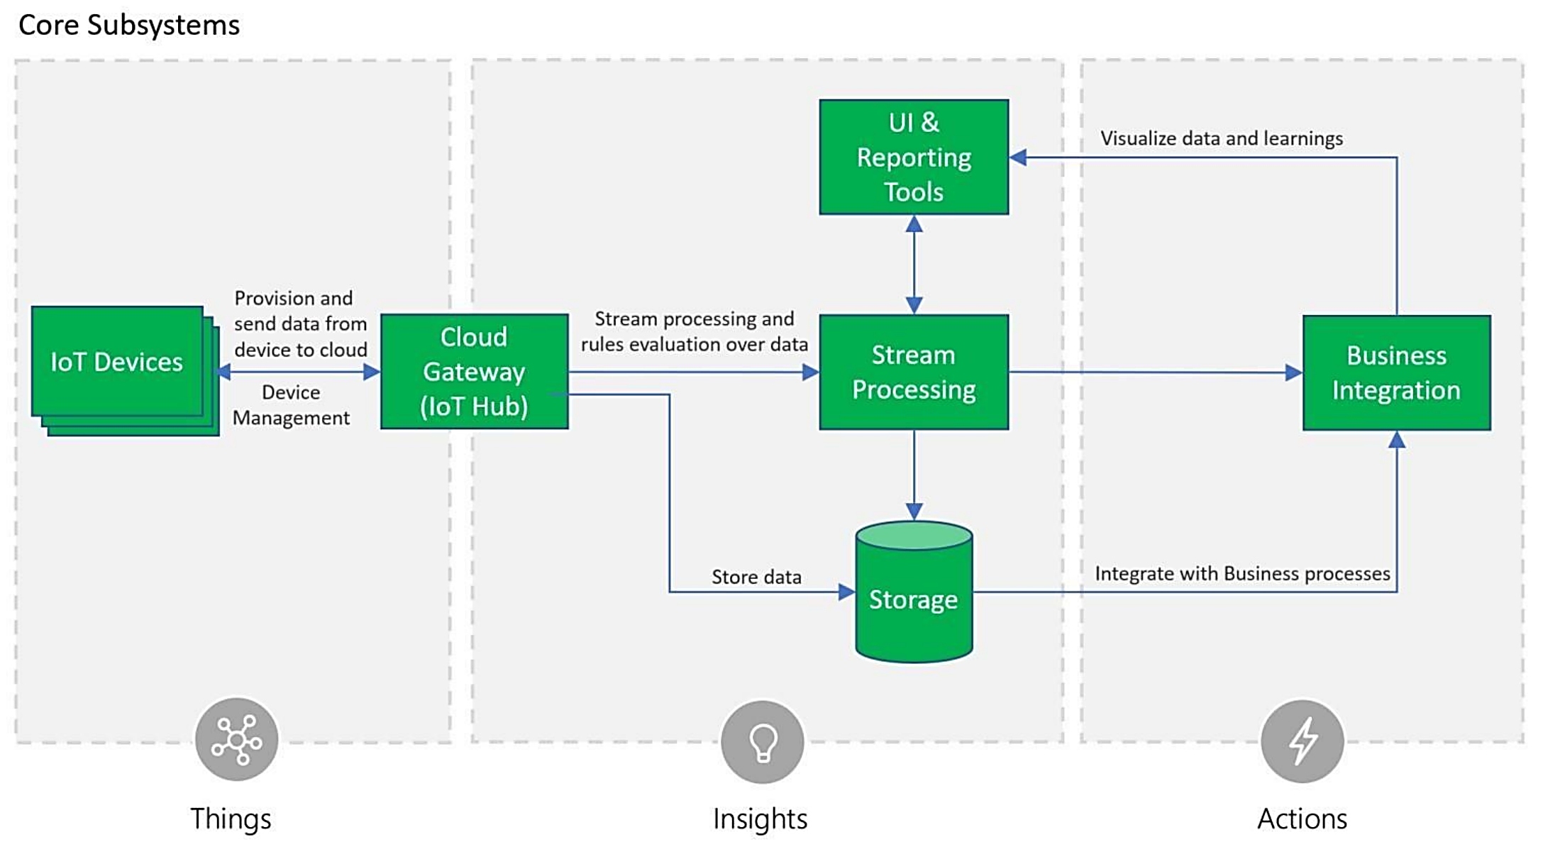
Core Subsystems
https://azure.microsoft.com/en-us/resources/microsoft-azure-iot-reference-architecture/
Notes:
At the core an IoT application consists of the following subsystems: 1) devices (and/or on premise edge gateways) that have the ability to securely register with the cloud, and connectivity options for sending and receiving data with the cloud, 2) a cloud gateway service, or hub, to securely accept that data and provide device management capabilities, 3) stream processors that consume that data, integrate with business processes, and place the data into storage, and 4) a user interface to visualize telemetry data and facilitate device management. Following, these subsystems are briefly described with prescriptive technology recommendations. Sections covering these subsystems in depth are in section 3 of this document.

Slide 51
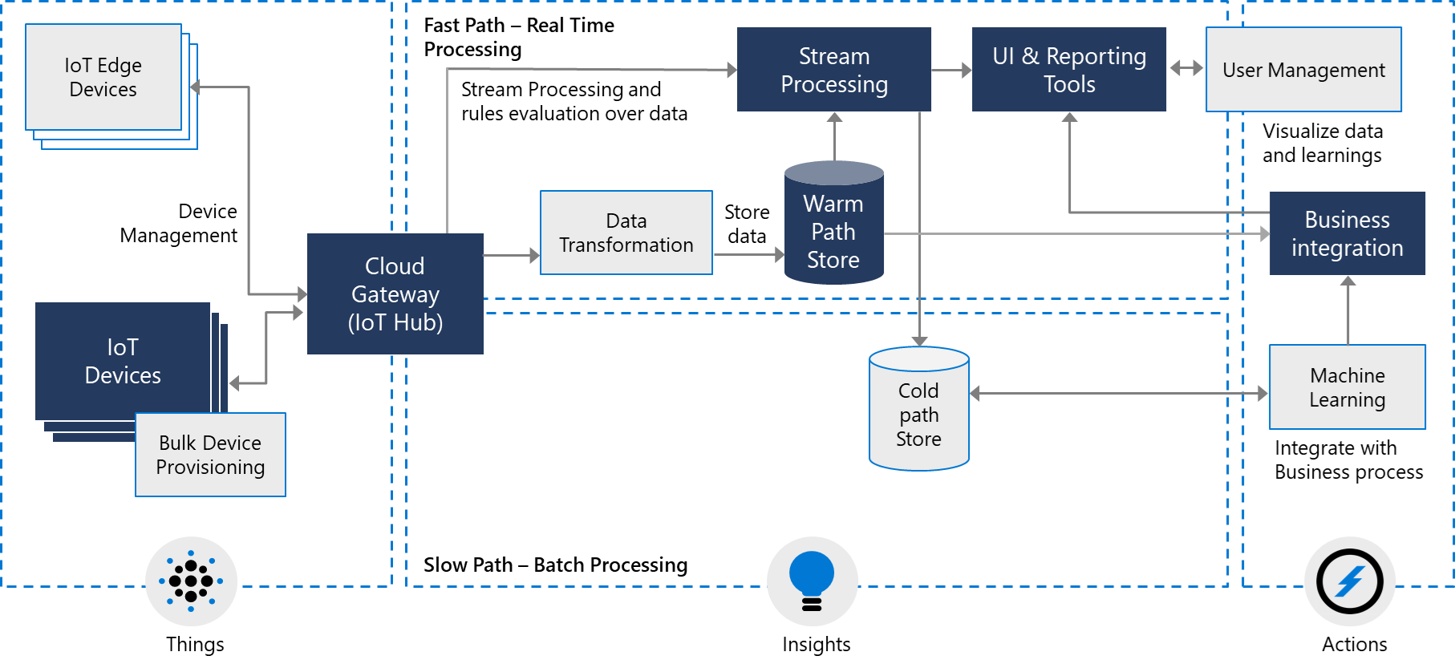
Optional Subsystems
Notes:
In addition to the core subsystems many IoT applications will include subsystems for: 5) intelligent edge devices which allow aggregation or transformation of telemetry data and on premise processing, 6) cloud telemetry data transformation which allows restructuring, combination, or transformation of telemetry data sent from devices, 7) machine learning which allows predictive algorithms to be executed over historical telemetry data, enabling scenarios such as predictive maintenance, and 8) user management which allows splitting of functionality amongst different roles and users.

Slide 52
Cross-Cutting IoT application needs
Notes:
There are multiple cross-cutting needs for IoT applications that are critical for success including: 9) security requirements; including user management and auditing, device connectivity, in-transit telemetry, and at rest security, 10) logging and monitoring for an IoT cloud application is critical for determining health and for troubleshooting failures both for individual subsystems and the application as a whole, and 11) high availability and disaster recovery which is used to rapidly recover from systemic failures.

Slide 53
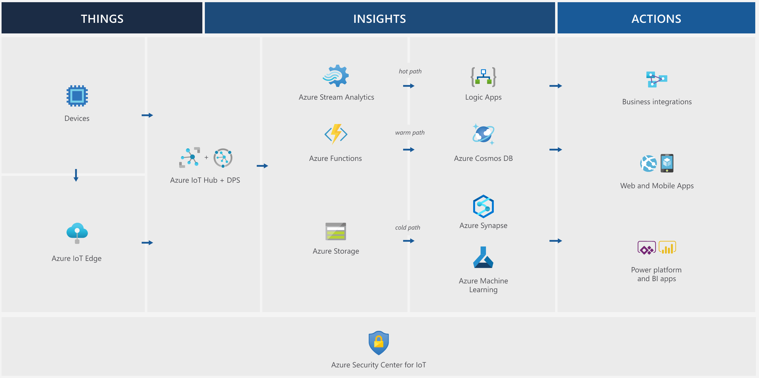
Azure IoT reference architecture

Slide 54
Data & BI

Slide 55
Enterprise business intelligence
This reference architecture implements an extract, load, and transform (ELT) pipeline that moves data from an on-premises SQL Server database into Azure Synapse and transforms the data for analysis.

Slide 56
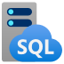



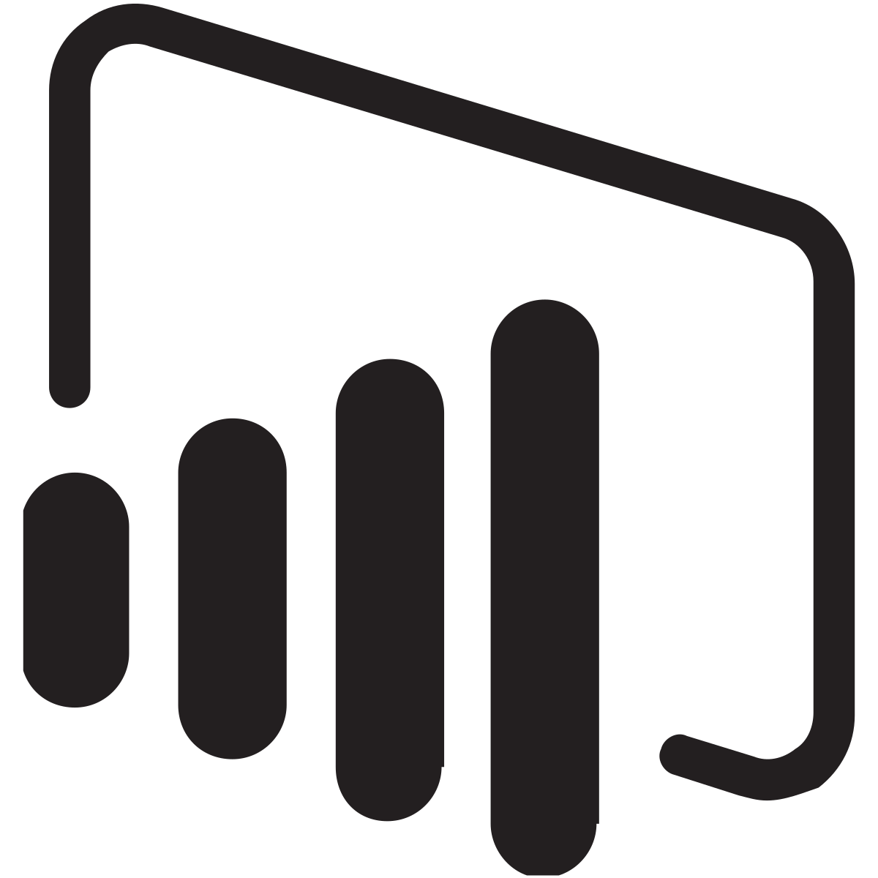

Enterprise business intelligence
Data Source
Ingestion
Data storage
Analysis
Visualization
On-premises network
Blob
Storage
Azure
Synapse
Analysis Service
Power BI
Authentication
https://github.com/mspnp/azure-sqldw-enterprise-bi
Azure Active Directory

Slide 57
Enterprise business intelligence
Scenario: An organization has a large OLTP data set stored in a SQL Server database on premises.
The organization wants to use Azure Synapse to perform analysis using Power BI.
Notes:
This reference architecture is designed for one-time or on-demand jobs. If you need to move data on a continuing basis (hourly or daily), we recommend using Azure Data Factory to define an automated workflow

Slide 58
Advanced Analytics Architecture
Transform your data into actionable insights using the best-in-class machine learning tools.
This architecture allows you to combine any data at any scale, and to build and deploy custom machine learning models at scale.

Slide 59
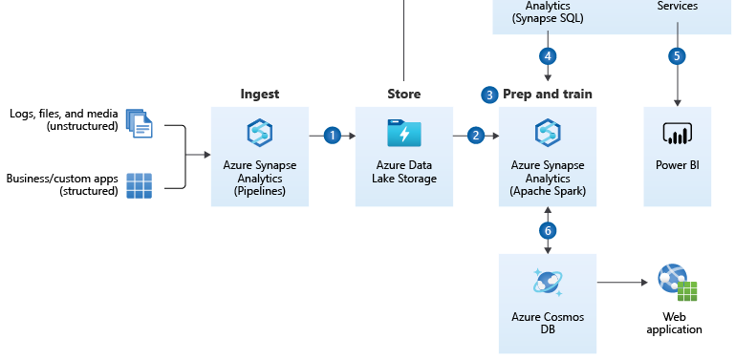
Advanced Analytics Architecture
Notes:
Bring together all your structured, unstructured and semi-structured data (logs, files, and media) using Synapse Pipelines to Azure Data Lake Storage.
Use Apache Spark pools to clean and transform the structureless datasets and combine them with structured data from operational databases or data warehouses.
Use scalable machine learning/deep learning techniques, to derive deeper insights from this data using Python, Scala or .NET, with notebook experiences in Apache Spark pool.
Leverage Apache Spark pool and Synapse Pipelines in Azure Synapse Analytics to access and move data at scale.
Query and report on data in Power BI.
Take the insights from Apache Spark pools to Cosmos DB to make them accessible through web and mobile apps.

Slide 60
Enterprise Data Warehouse Architecture
An enterprise data warehouse lets you bring together all your data at any scale easily, and to get insights through analytical dashboards, operational reports, or advanced analytics for all your users.

Slide 61
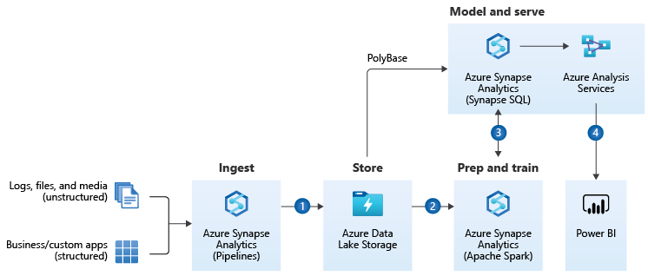
Enterprise Data Warehouse Architecture
Notes:
Combine all your structured, unstructured and semi-structured data (logs, files, and media) using Azure Synapse Analytics Pipelines to Azure Blob Storage.
Leverage data in Azure Blob Storage to perform scalable analytics with Azure Synapse Analytics Spark pool and achieve cleansed and transformed data.
Cleansed and transformed data can be combined with existing structured data, creating one hub for all your data with Azure Synapse Analytics.
Build operational reports and analytical dashboards on top of dedicated SQL pool to derive insights from the data, and use Azure Analysis Services to serve thousands of end users.
Components
Azure Synapse Analytics is the fast, flexible, and trusted cloud data warehouse that lets you scale, compute, and store elastically and independently, with a massively parallel processing architecture.
Synapse Pipelines Documentation allows you to create, schedule and orchestrate your ETL/ELT workflows.
Azure Blob storage is a Massively scalable object storage for any type of unstructured data-images, videos, audio, documents, and more-easily and cost-effectively.
Azure Synapse Analytics Spark pools is a parallel processing framework that supports in-memory processing to boost the performance of big-data analytic applications.
Azure Analysis Services is an enterprise grade analytics as a service that lets you govern, deploy, test, and deliver your BI solution with confidence.
Power BI is a suite of business analytics tools that deliver insights throughout your organization. Connect to hundreds of data sources, simplify data prep, and drive ad hoc analysis. Produce beautiful reports, then publish them for your organization to consume on the web and across mobile devices.

Slide 62
Real Time Analytics on Big Data Architecture
Get insights from live streaming data with ease. Capture data continuously from any IoT device, or logs from website clickstreams, and process it in near-real time.
Notes:
This reference architecture shows how to train a recommendation model using Azure Databricks and deploy it as an API by using Azure Cosmos DB, Azure Machine Learning, and Azure Kubernetes Service (AKS). This architecture can be generalized for most recommendation engine scenarios, including recommendations for products, movies, and news.

Slide 63
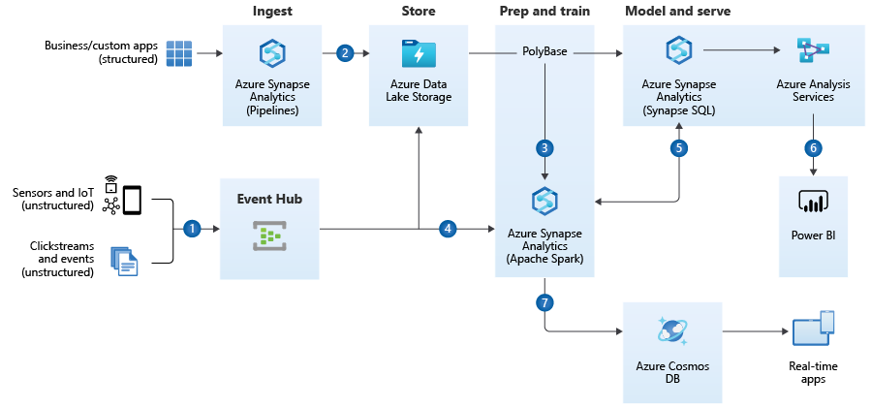
Real Time Analytics on Big Data Architecture
Notes:
Easily ingest live streaming data for an application using Azure Event Hubs.
Bring together all your structured data using Synapse Pipelines to Azure Blob Storage.
Take advantage of Apache Spark pools to clean, transform, and analyze the streaming data, and combine it with structured data from operational databases or data warehouses.
Use scalable machine learning/deep learning techniques, to derive deeper insights from this data, using Python, Scala, or .NET, with notebook experiences in Apache Spark pools.
Leverage Apache Spark pool and Synapse Pipelines in Azure Synapse Analytics to access and move data at scale.
Build analytics dashboards and embedded reports in dedicated SQL pool to share insights within your organization and use Azure Analysis Services to serve this data to thousands of users.
Take the insights from Apache Spark pools to Cosmos DB to make them accessible through real time apps.
Azure Synapse Analytics is the fast, flexible and trusted cloud data warehouse that lets you scale, compute and store elastically and independently, with a massively parallel processing architecture.
Synapse Pipelines Documentation allows you to create, schedule and orchestrate your ETL/ELT workflows.
Azure Data Lake Storage: Massively scalable, secure data lake functionality built on Azure Blob Storage
Azure Synapse Analytics Spark pools is a fast, easy, and collaborative Apache Spark-based analytics platform.
Azure Azure Event Hubs Documentation is a big data streaming platform and event ingestion service.
Azure Cosmos DB is a globally distributed, multi-model database service. Then learn how to replicate your data across any number of Azure regions and scale your throughput independent from your storage.
Azure Analysis Services is an enterprise grade analytics as a service that lets you govern, deploy, test, and deliver your BI solution with confidence.
Power BI is a suite of business analytics tools that deliver insights throughout your organization. Connect to hundreds of data sources, simplify data prep, and drive ad hoc analysis. Produce beautiful reports, then publish them for your organization to consume on the web and across mobile devices.

Slide 64
Thank You
Q & A

